Slide 1

Problem Solving Session
The remainder of today’s class will comprise the problem solving session (PSS).
Your instructor will divide you into teams of 3 or 4 students.
Each team will work together to solve the following problems over the course of 20-30 minutes.
You may work on paper, a white board, or digitally as determined by your instructor.
You will submit your solution by pushing it to GitHub before the end of class.
Your instructor will go over the solution before the end of class.
If there is any time remaining, you will begin work on your homework assignment.
Class participation is a significant part of your grade (20%). This includes in class activities and the problem solving session.
Your Course Assistants will grade your participation by verifying that you pushed your solutions before the end of the class period each day.

Slide 2

Problem Solving Team Members
Record the name of each of your problem solving team members here.
Do not forget to add every team member’s name! Your instructor (or course assistant) may or may not use this to determine whether or not you participated in the problem solving session.

Slide 3
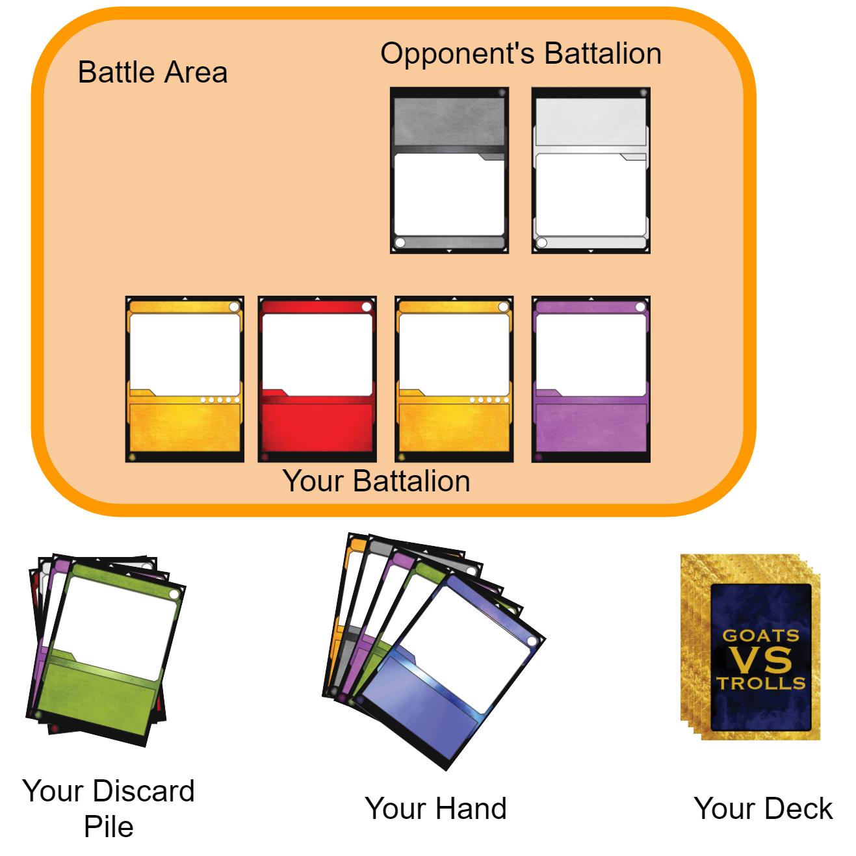
Goats vs. Trolls
Goats vs. Trolls is a CCG in which two players battle until one or both scores are reduced to 0.
The game ends in a draw if both players reach a score of 0 in the same round.
Otherwise, the loser is the player whose score reaches 0 first.
During the game players:
Draw cards from a deck into their hand.
Spend resource points to play cards from their hand into their battalion.
Battalions do battle and damage each other.
Cards defeated in battle are discarded.
Any extra damage is dealt to the player's score.
Cards also have powers that are activated.
Some powers only activate under certain circumstances.
Some powers are single use.
The layout of a Goats vs. Trolls game from the perspective of one player. You will implement methods that allow players to draw, play, and discard cards as well as do battle.

Slide 4
Problem Solving 1
In the last unit, you should have written several classes that comprise the core of a GvT game including at least:
Power
Card
Player
Recall that a power has at least three attributes: a name, a description, and a power function. Some powers are also single use.
Work together with your team to write the class using proper encapsulation, meaning that all of the fields should be private.
Do not worry about methods yet.

Slide 5
Problem Solving 2
class Power:
# write the power's activate function. this
# may or may not call its power function!
class Card:
# write the card's activate function. this
# should activate its power (or try to)
A power function may affect a card (e.g. by adding to the card's health or attack power) and/or the player (e.g. by adding to the player's the score or resource points). Because of this, both the card and player must be passed into the function when it is called.
Some power functions only activate under certain circumstances (e.g. the card is under 25% health). The function should return True if it activates and False otherwise.
A power may be activated. This does not mean that its power function will be called! Some powers are single-use, and so the power will need to check for that. In the space to the left, write the method that should be called when a power is activated.
Then, write the corresponding method that is called on the card to activate its power. Remember that the card may not have a power!

Slide 6
Problem Solving 3
When players do battle against each other, the total damage for each battalion is determined at the start of battle. This is the sum of the attack power of all of the player's cards currently in play.
Write the method that computes the player's total damage at the start of battle. You may assume that this will be a method called on the player class and that the card class defines the accessor(s) needed to get the card's attack power.

Slide 7
Problem Solving 4
class Card:
# write the function to damage a card
class Player:
# write the function to damage the battalion
When a card sustains damage, the damage is subtracted from the card's current health. If the card's health is reduced to 0, it is defeated. Any leftover damage is returned.
For example, if the damage is 8 and the card's current health is 5, the health is reduced to 0 and the leftover damage returned is 3.
Write the method that is called on a card when it takes damage in battle.
Time permitting, write the function that is called on the player to damage its entire battalion. You may assume that the card class defines the accessor(s) needed to get the card's current health. Cards that are defeated are removed from the battalion.
For now, do not worry about subtracting remaining damage from the player's score.

